Slide 1


ZENTHOR
Erode Sengunthar Engineering College
(An Autonomous Institution)
Perundurai, Erode - 638057
An Intelligent Career Guidance System
Using Artificial Intelligence
UNDER THE GUIDANCE OF
Mr. D. Vijaybabu,
Assistant Professor,
Department of Information Technology
PRESENTED BY
Abhimanyu.C ES22IT01
Kiruthik.M ES22IT47
MD Saif Ansari ES22IT63
Gunasekaran M S ES22IT305

Slide 2
Introduction
Choosing a career is one of the most important and life-defining decisions.
Rapid growth in career options creates confusion among students.
Traditional counseling lacks personalization and scalability.
Students lack awareness of skills and job trends.
AI enables data-driven and intelligent career guidance.
Zenthor helps users make informed career decisions.

Slide 3
About Zenthor
AI-powered career guidance system.
Analyzes skills, interests, and academic data.
Provides personalized career recommendations.
Acts as a 24/7 virtual mentor.
Suggests learning paths, courses, and projects.
Bridges gap between skills and industry.

Slide 4
Need for the System
Increase in career options causes confusion.
Lack of awareness in students.
Skill gap between education and industry.
Rapid changes in job market trends.
Traditional systems not scalable.
Need for intelligent guidance system.

Slide 5
Problem Statement
Students struggle to choose correct career path.
Existing systems are generic and outdated.
No real-time job market analysis.
Lack of personalization.
No continuous tracking system.
Leads to wrong career decisions.

Slide 6
Objectives
Develop AI-based career system.
Analyze user data for insights.
Provide accurate recommendations.
Identify skill gaps.
Support continuous learning.
Improve employability.

Slide 7
Limitations of Existing System
The system does not provide personalized recommendations.
It is time-consuming and depends on manual counseling.
No real-time updates about job market trends.
Relies on human judgment, which may be biased.
No proper skill gap analysis for users.
Does not support continuous career tracking.
Not scalable for large number of users.
Limited accessibility for remote users.

Slide 8
Proposed System
Zenthor is an AI-powered career guidance system.
Analyzes skills, interests, and academic background.
Uses Artificial Intelligence and Machine Learning.
Provides real-time career recommendations.
Includes skill gap analysis and learning paths.
Supports continuous monitoring and updates.
Highly scalable and efficient.
Accessible anytime as a virtual mentor.

Slide 9
Advantages of Proposed System
Provides personalized career suggestions.
Fast and accurate results using AI.
Real-time updates based on industry trends.
Improves decision-making with data insights.
Identifies and improves skill gaps.
Supports continuous learning and growth.
Accessible anytime and anywhere.
Reduces cost and dependency on counselors.

Slide 10
System Architecture - Overview
Designed for efficient data flow.
Consists of UI, Backend, Database, AI Engine.
Ensures smooth interaction between components.
Supports real-time processing.
Handles multiple users efficiently.

Slide 11
System Architecture - Backend & DB
Backend handles processing and API communication.
Manages user requests and system logic.
Database stores user data securely.
Efficient data retrieval and storage.
Supports future analysis and scalability.

Slide 12
System Architecture - AI Engine
Core component of the system.
Uses machine learning algorithms.
Performs prediction and recommendation.
Analyzes user data effectively.
Improves with feedback and new data.
Ensures accuracy and performance.

Slide 13
Data Collection
Collects user profile including education and background
Captures skills, interests, and preferences
Includes academic performance and certifications
Tracks career goals and ambitions
Collects project and experience details
Uses forms and questionnaires
Ensures accuracy and completeness
Continuously updates user data
Maintains data privacy and security

Slide 14
Data Processing
Performs data cleaning to remove errors
Handles missing and incomplete data
Converts raw data into structured format
Applies normalization techniques
Extracts important features
Encodes data for machine learning
Improves data quality
Prepares dataset for ML models
Ensures efficient processing

Slide 15
Machine Learning Model
Uses classification algorithms for prediction
Implements recommendation systems
Trained on career datasets
Analyzes patterns in user data
Provides intelligent outputs
Improves accuracy with feedback
Supports supervised learning
Handles multiple career options
Optimizes performance continuously

Slide 16
Recommendation Engine
Suggests suitable career paths
Recommends required skills
Provides course suggestions
Generates personalized roadmap
Adapts based on user profile
Uses hybrid recommendation methods
Updates recommendations regularly
Provides multiple options
Enhances decision-making

Slide 17
Skill Gap Analysis
Compares user skills with job requirements
Identifies missing skills
Suggests improvements
Provides learning resources
Tracks user progress
Highlights strengths and weaknesses
Recommends certifications
Improves employability
Supports career readiness

Slide 18
Career Prediction
Predicts best career path using AI
Based on user data and trends
Considers job market demand
Provides multiple career options
Uses historical data analysis
Improves prediction accuracy
Adapts to changes
Ensures reliability
Supports decision-making

Slide 19
Technologies Used
HTML, CSS, JavaScript for frontend
React.js for UI
Node.js for backend services
NeonDB for database
Gemini APIs for integration
Visualization tools

Slide 20
User Interface
Simple and intuitive design
Easy navigation
Interactive dashboard
Displays results clearly
Responsive for all devices
User-friendly forms
Attractive layout
Real-time interaction
Improves user experience

Slide 21
Key Features
Personalized career guidance
Skill tracking system
AI-based recommendations
Continuous monitoring
Learning path suggestions
Real-time updates
User-friendly interface
Data-driven insights
Career roadmap generation

Slide 22
Additional Features
Resume building suggestions
Certification recommendations
Job alerts
Progress tracking dashboard
Feedback system
Integration with learning platforms
Custom reports
Goal setting
Performance analytics

Slide 23
Security Features
Secure login authentication
Data encryption
User privacy protection
Safe data storage
Access control
Prevents unauthorized access
Ensures data integrity
Regular updates
Backup and recovery

Slide 24
Performance Analysis
Measures prediction accuracy
Evaluates response time
Tracks user engagement
Analyzes efficiency
Uses feedback for improvement
Ensures reliability
Handles large users
Optimizes performance
Maintains consistency

Slide 25
Applications
Used in colleges
Career counseling centers
Online platforms
Job seekers
Recruitment systems
Training institutes
Supports professionals
Improves employability
Guides career planning

Slide 26
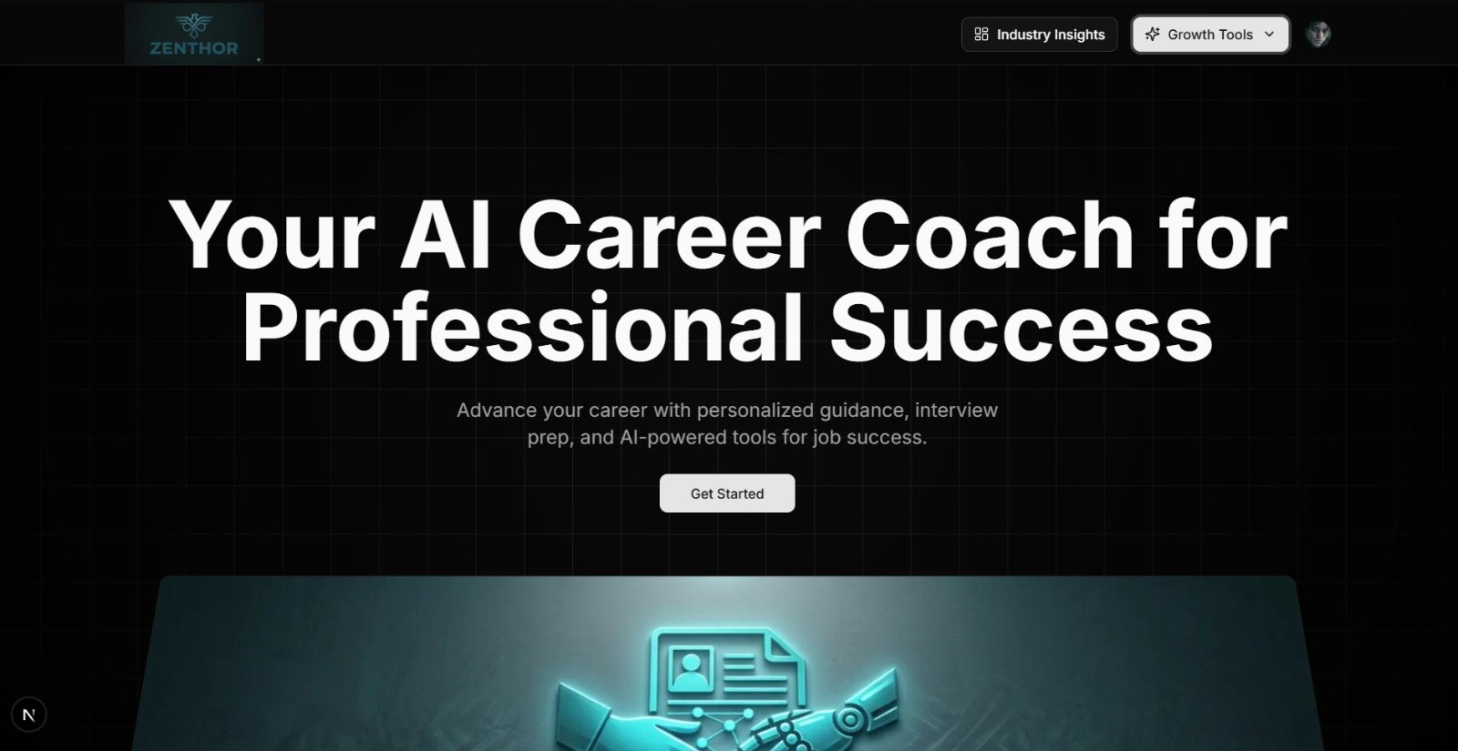
Hero Page

Slide 27
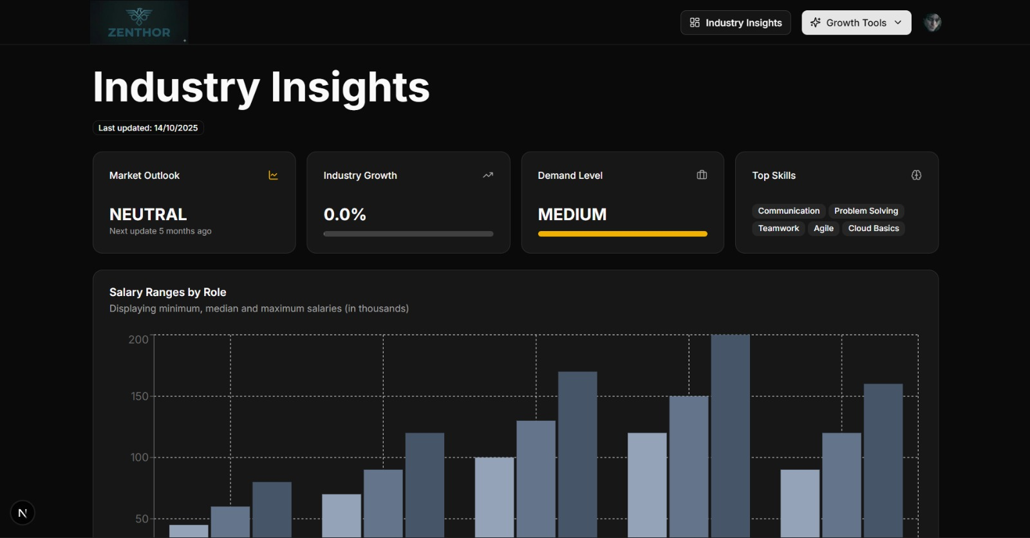
Industry Insights

Slide 28
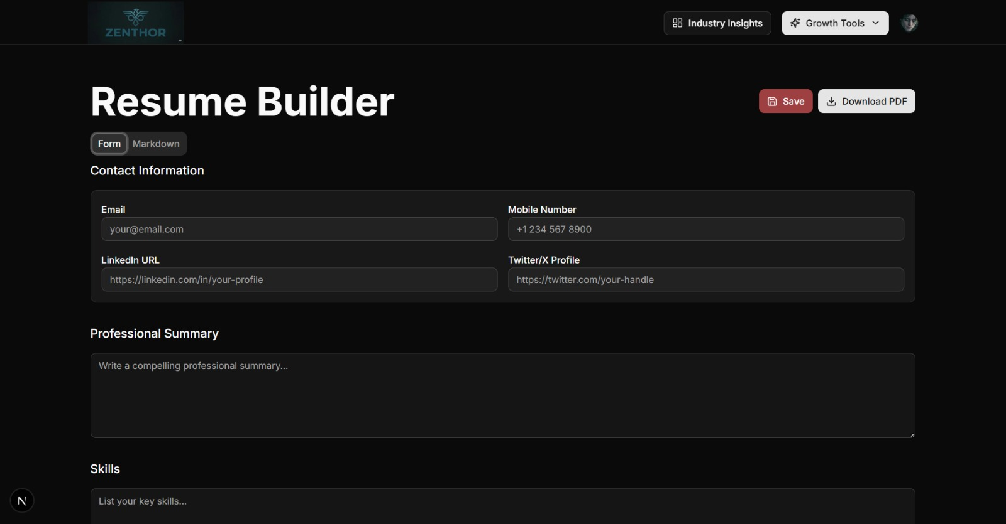
Resume Builder

Slide 29
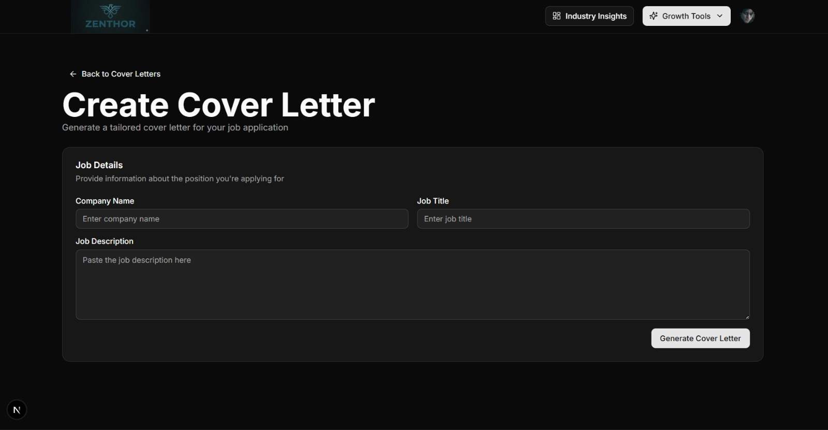
Create Cover Letter

Slide 30
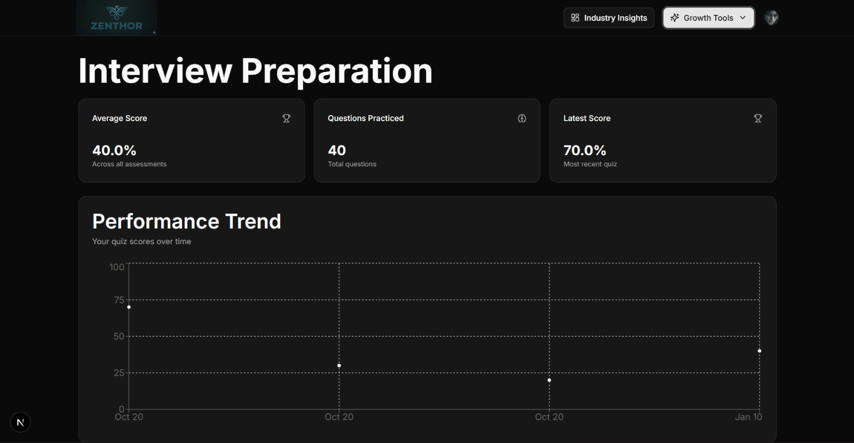
Interview Preparation

Slide 31
Future Enhancements
Mobile app development
AI chatbot integration
Voice assistant
Advanced ML models
Better UI/UX
Job portal integration
Real-time analytics
Cloud deployment
Global reach

Slide 32
Conclusion
Zenthor simplifies career decisions
Provides intelligent recommendations
Uses AI for accuracy
Enhances user experience
Supports long-term growth
Bridges skill gap
Improves employability
Personalized guidance
Future-ready system

Slide 33
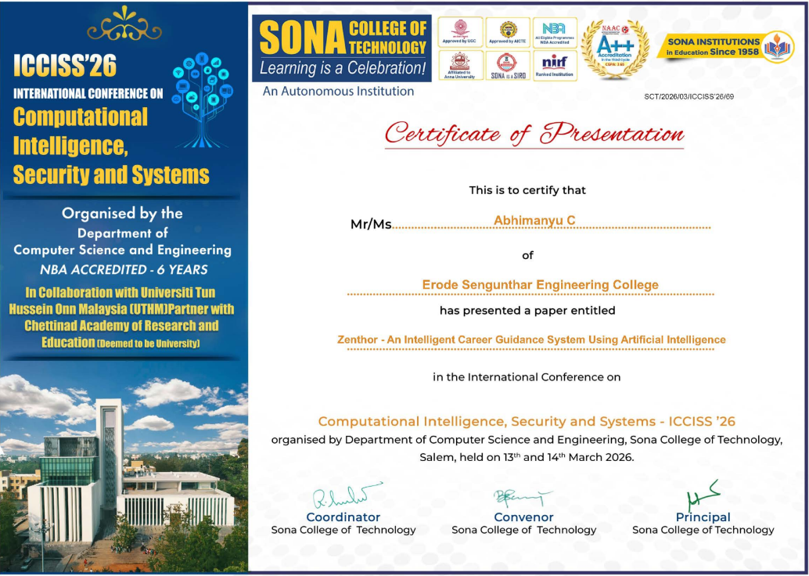

Slide 34


Slide 35


Slide 36


